Slide 1
6 Input Analysis
Ref: Law & Kelton, Chapter 6
JPC

Slide 2
Driving simulation models
Stochastic simulation models use random variables to represent inputs such as inter-arrival times, service times, probabilities of storms, proportion of ATM customers making a deposit.
We need to know the distribution family and parameters of each of these random variables.
Some methods to do this:
Collect real data, and feed this data to the simulation model. This is called trace-driven simulation.
Collect real data, build an empirical distribution of the data, and sample from this distribution in the simulation model.
Collect real data, fit a theoretical distribution to the data, and sample from that distribution in the simulation model.
We will examine the last two of these methods.
JPC

Slide 3
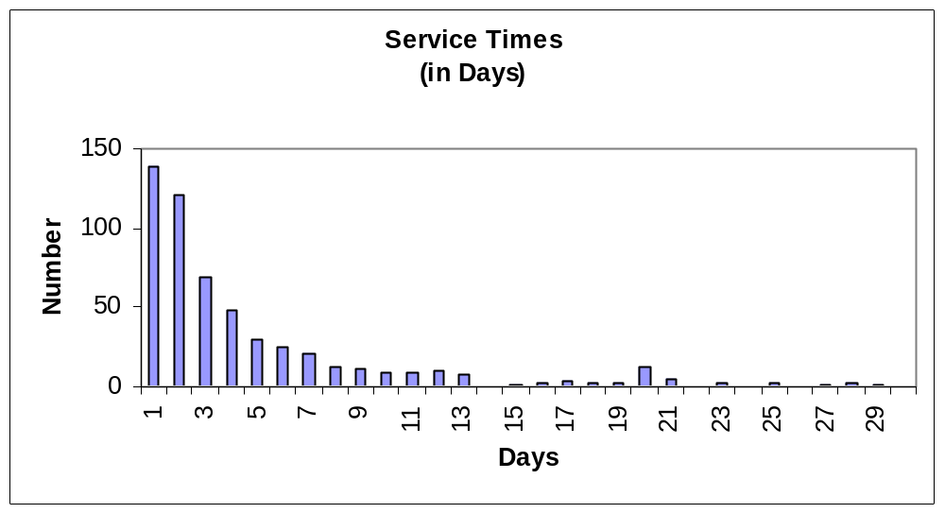
Why Is This an Issue?
N = 546
The above graph shows service times (LOS) for a hospital in Ontario. How would you model a patient’s length of stay?
JPC

Slide 4
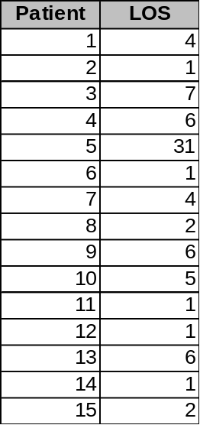
Option 1: Trace
We could attempt a trace. In this scheme, we would hold this list of numbers in a file.
When we generate the first patient, we would assign him or her an LOS of 4; the 2nd 1; the 3rd 7; …
Traces have the advantage of being simple and reproducing the observed behaviour exactly.
Traces don’t allow us to generate values outside of our sample.
Our sample is usually of a limited size, meaning that we may not have observed the system in all states.
JPC

Slide 5
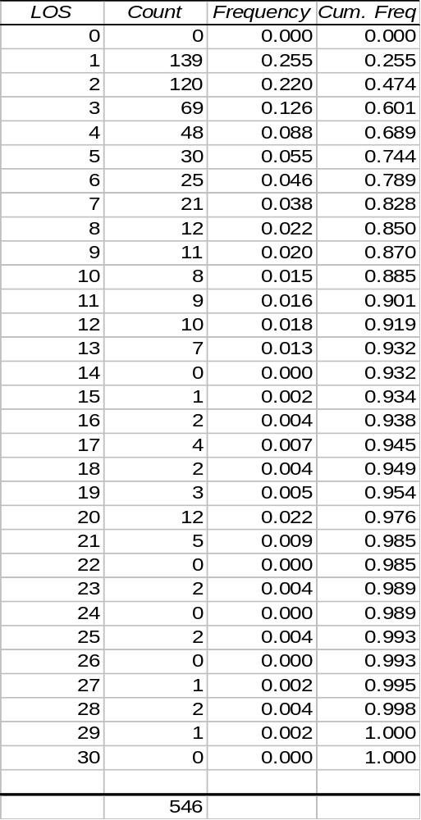
Option 2: Empirical Distribution
A second idea might be to use an empirical distribution to model LOS.
We will use the LOS and cumulative frequency as an input to our model.
The LOS will represent x, and the cumulative frequency represents F(x).
For instance, assume we pick a random number (say .62) as F(x). This corresponds to x of between 3 and 4 (~3.3 by interpolation).
Empirical distributions may however, be based on a small sample size and may have irregularities.
The empirical distribution cannot generate an x value outside of the range [lowest observed value, highest observed value].
JPC

Slide 6
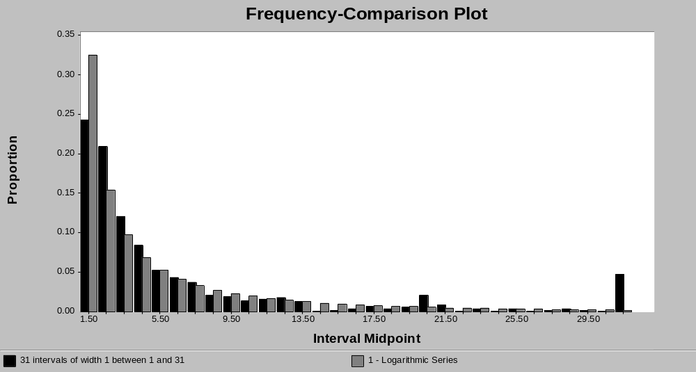
Option 3: Fitted Distribution
JPC

Slide 7
Why Theoretical Distributions?
Theoretical distributions “smooth out” the irregularities that may be present in trace and empirical distributions.
Gives the simulation the ability to generate wider range of values.
  Test extreme conditions.
There may a compelling reason to use a theoretical distribution.
Theoretical distributions are a compact way to represent very large datasets.
JPC

Slide 8
Describing Distributions
A probability distribution is described by its family and its parameters. The choice of family is usually made by examining the density function, because this tends to have a unique shape for each distribution family.
Distribution parameters are of three types:
location parameter(s) γ
scale parameter(s) β
shape parameter(s) α
f(x)
γ₁
γ₂
γ₃
x
β ₃
f(x)
f(x)
α ₁
β ₂
α ₂
α ₃
β ₁
x
x
JPC

Slide 9
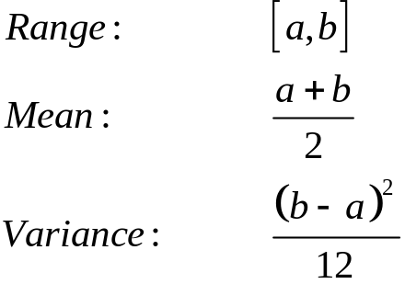

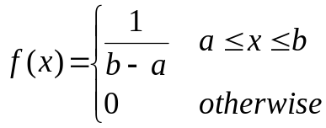
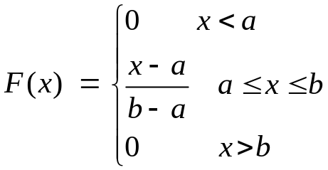
Examples: continuous distributions
Uniform distribution (a is the location parameter; (b-a) is the shape parameter)
f(x)
a
b
x
Uses: 1st model in which only a, b are known.
Essential for generation of other distributions.
JPC

Slide 10
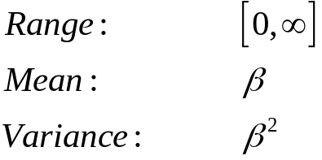

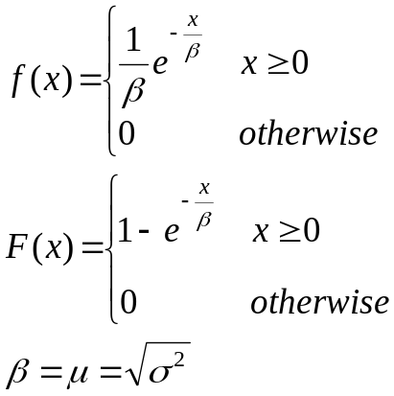
Examples: continuous distributions
Exponential distribution (one scale parameter)
f(x)
x
Uses: Inter-arrival times.
Notes: Special case of Weibull and Gamma (α = 1 , β = β)
If X₁, X₂, …, X_{m} are independent expo(β) then X₁+ X₂+ …+ X_{m} is distributed as an m-Erlang or gamma(m, β)
JPC

Slide 11
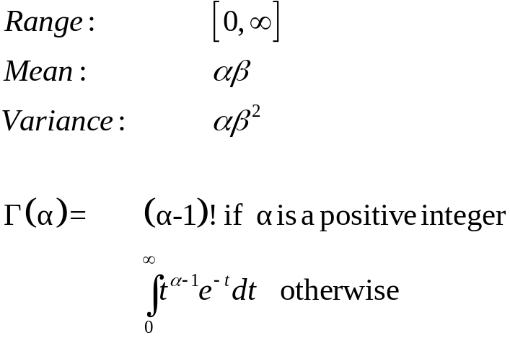
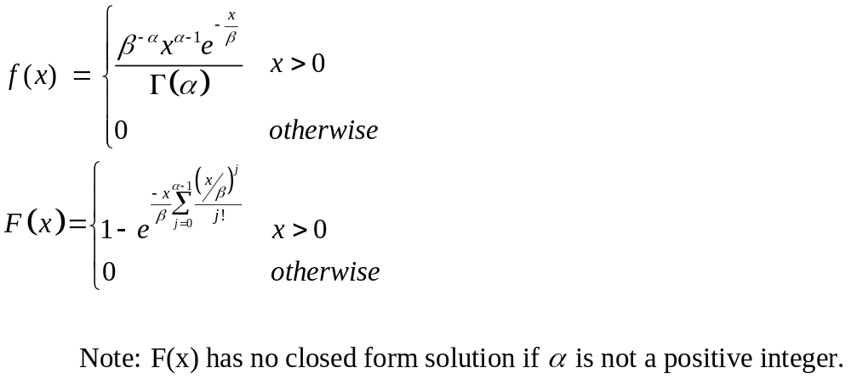
Examples: continuous distributions ...
Gamma distribution (one scale parameter,one shape parameter)
f(x)
α=1
β=1
α=2
α=3
x
Uses: Task completion time.
Notes: For positive integer (m) gamma (m, β) is an m-erlang.
If X₁, X₂, …, X_{n} are independent gamma(α_{i},β) then X₁+ X₂+ …+ X_{n} is distributed as an gamma (α₁ + α₂ +…+ α_{n}, β)
JPC

Slide 12
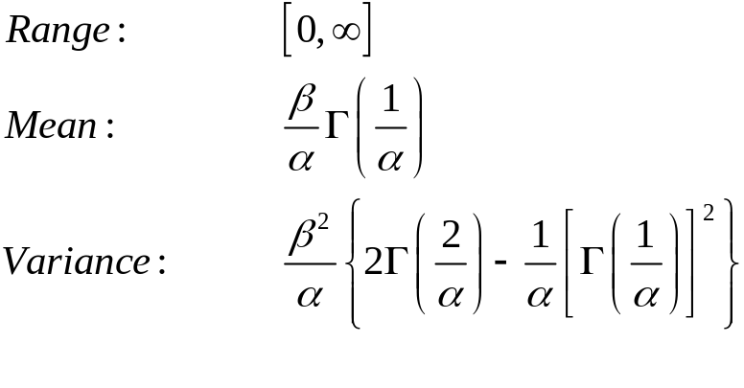
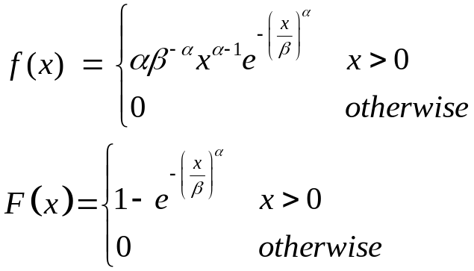
Examples: continuous distributions ...
Weibull distribution (one scale parameter,one shape parameter)
f(x)
α=1
β=1
α=2
x
Uses: Task completion time; equipment failure time
Notes: The expo(β) and the Weibull(1, β) are the same distribution.
JPC

Slide 13
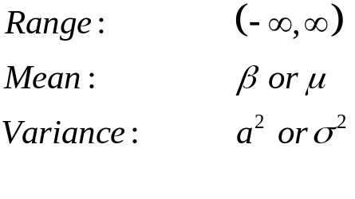
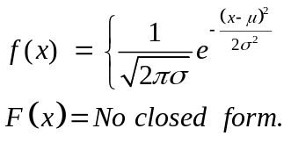
Examples: continuous distributions ...
Normal distribution (one scale parameter,one shape parameter)
f(x)
x
Uses: Errors from a set point. Quantities that are the sum of a large number of other quantities
Notes:
JPC

Slide 14
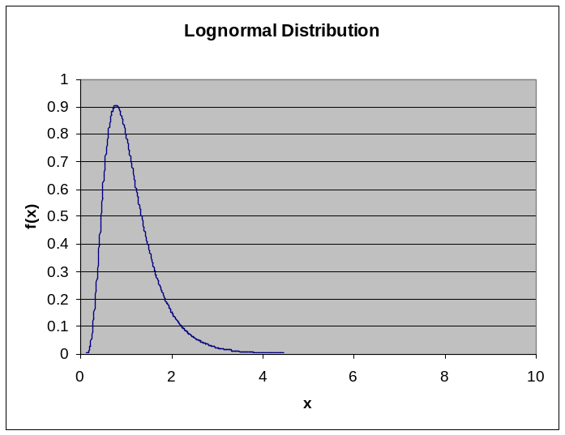
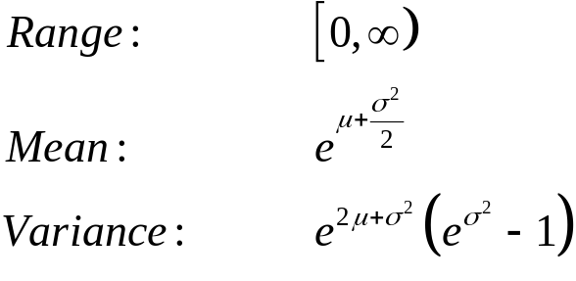
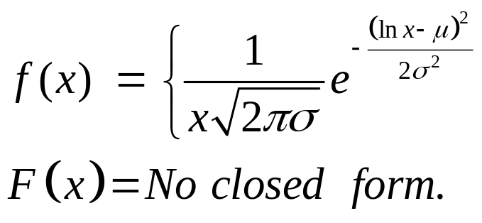
Examples: continuous distributions ...
Lognormal distribution (one scale parameter,one shape parameter)
Parameters: α is shape parameter – more commonly σ
β is scale parameter – more commonly μ
Uses: Time to perform some task
Notes: X~LN(μ, σ2) if and only if ln X ~ N(μ, σ2). Thus, if one has data that is thought to be lognormally distributed, then the logarithms of the data points can be treated as normally distributed for the purposes of hypothesizing a distribution, parameter estimation, and goodness of fit tests.
JPC

Slide 15
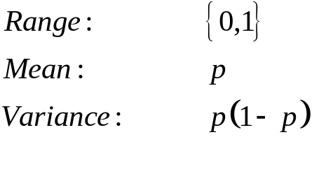
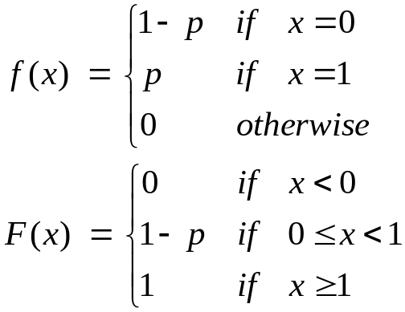
Examples: discrete distribution
Bernoulli distribution
p(x)
p
1-p
0
1
x
Uses: Outcome of an experiment that either succeeds or fails.
Notes: If X₁, X₂, …, X_{t} are independent Bernoulli trials, then X₁+X₂+ … + X_{t} is binomially distributed with parameters (t, p).
JPC

Slide 16
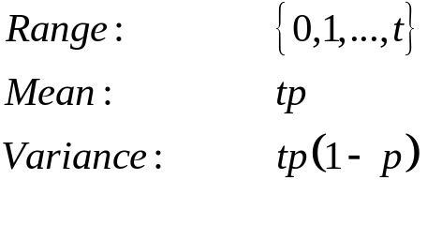
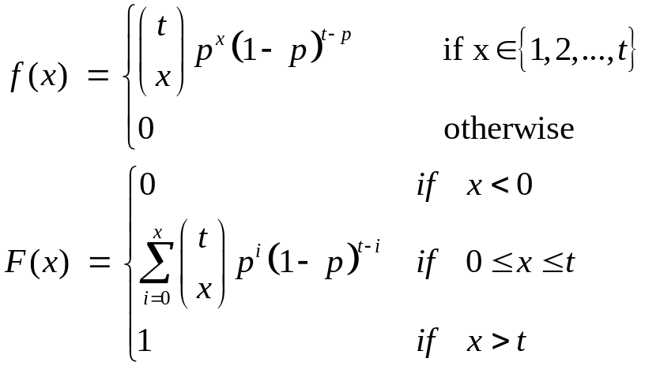
Examples: discrete distribution
Binomial Distribution
p(x)
t = 5
p = 0.5
p
0
1
2
3
4
5
x
Uses: Number of defectives in a batch of size t.
Notes: If X₁, X₂, …, X_{m} are independent and distributed bin(t_{i},p), then X₁+X₂+ … + X_{m} is binomially distributed with parameters (t₁ + t₂+ …+ t_{m}, p).
The binomial distribution is symmetric only if p = 0.5.
JPC

Slide 17
Selecting an Input Distribution - Family
The 1st step in any input distribution fit procedure is to hypothesize a family (i.e. exponential).
Prior knowledge about the distribution and its use in the simulation can provide useful clues.
  Normal shouldn’t be used for service times, since negative values can be returned.
Mostly, we will use heuristics to settle on a distribution family.
JPC

Slide 18
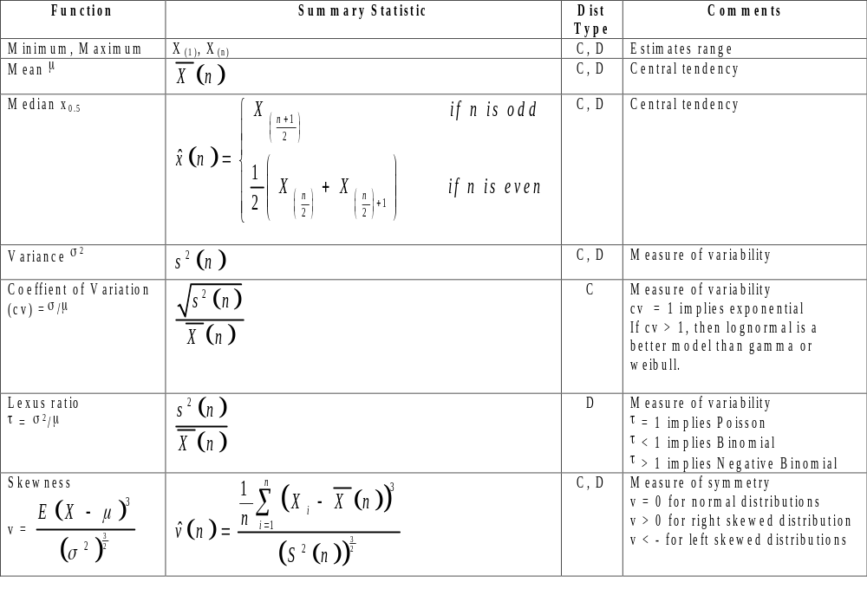
Summary Statistics

Slide 19
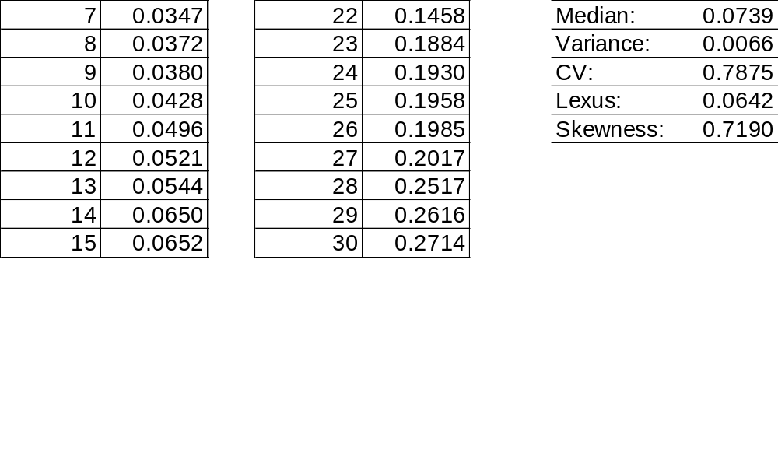
Summary Example
Consider the following sample
Continuous data
CV suggests NOT exponential
Skew suggests a left skewed family.
Conclusion: Gamma? Weibull? Beta?
JPC

Slide 20
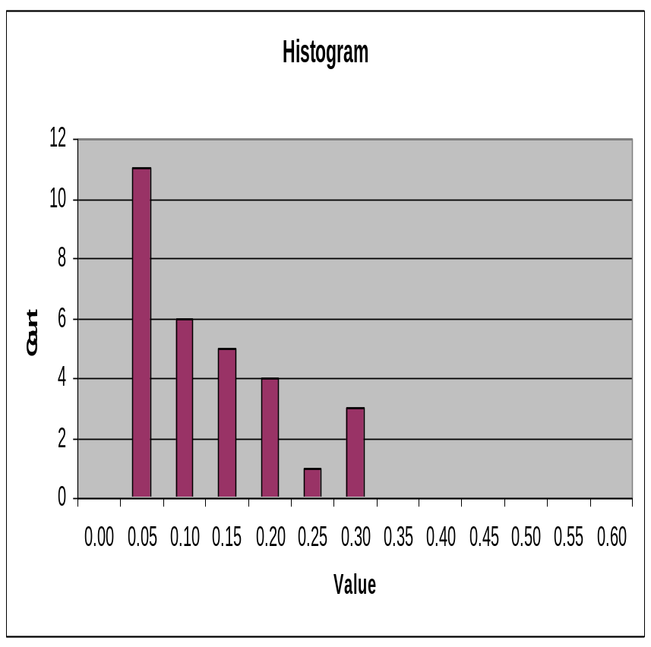
Draw a Histogram
Law & Kelton suggest drawing a histogram.
Use the plot to “eyeball” the family.
Law and Kelton suggest trying several plots with varying bar width.
Pick a bar width such that the plot isn’t too boxy, nor too scraggly.
JPC

Slide 21
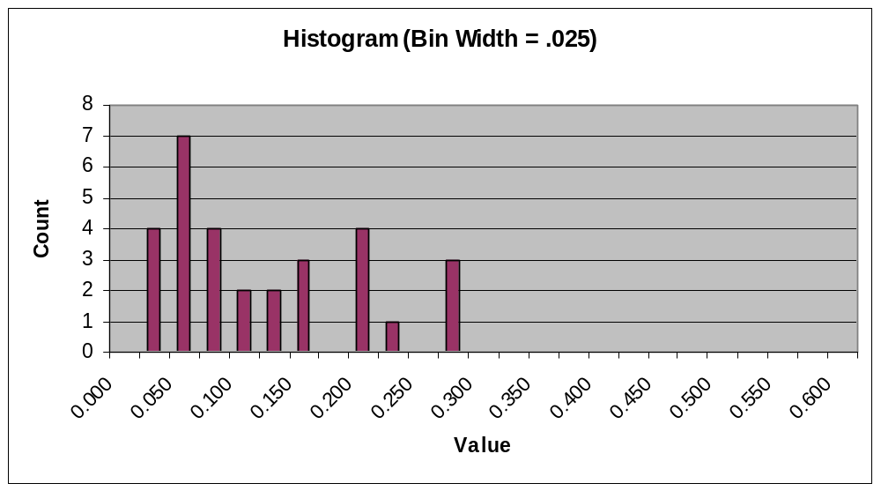
Histogram Example – I
JPC

Slide 22
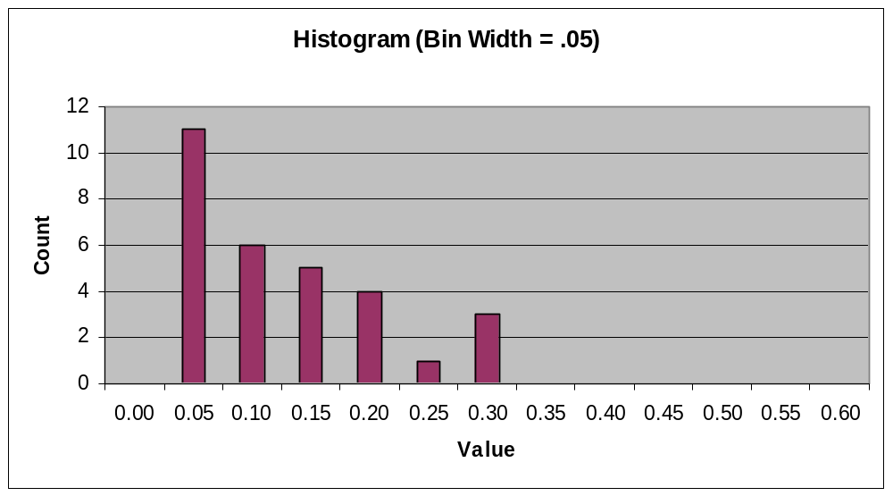
Histogram Example – II
JPC

Slide 23
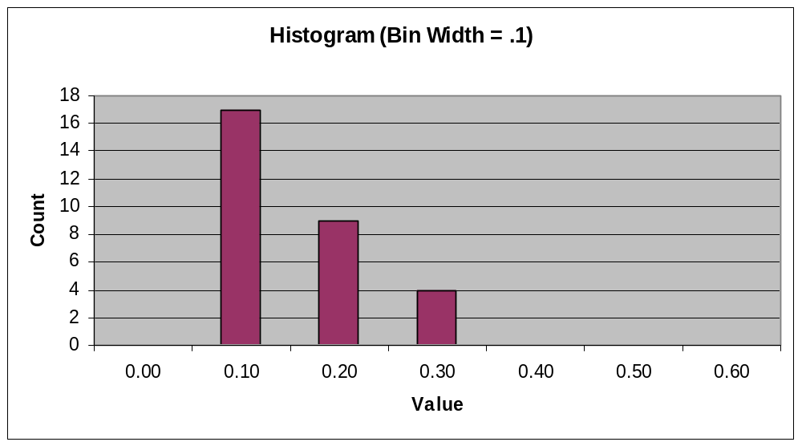
Histogram Example – III
JPC

Slide 24
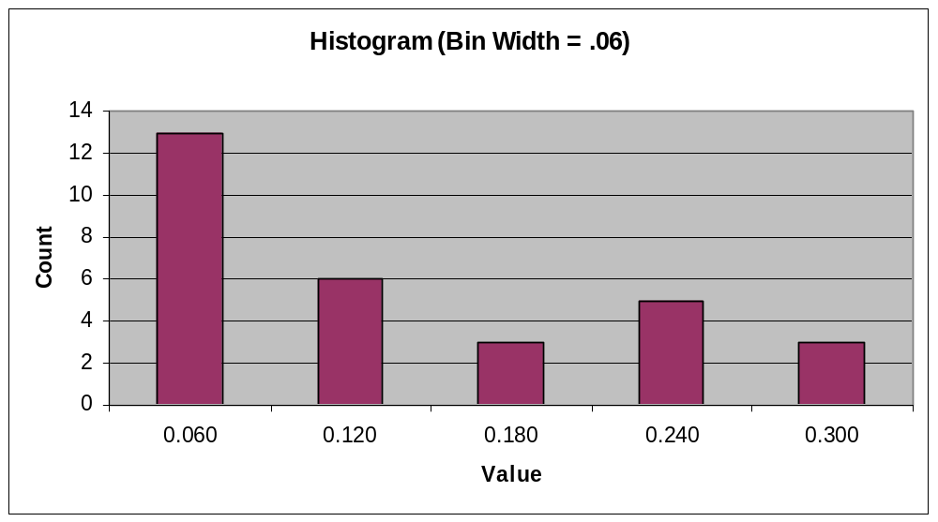
Sturge’s Rule
Select k (# bins): Int(1 + 3.322log₁₀n), where n = number of samples.
We will guess at a gamma distribution.
JPC

Slide 25
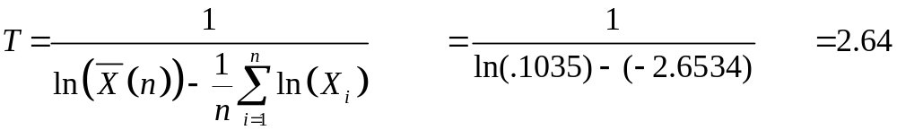
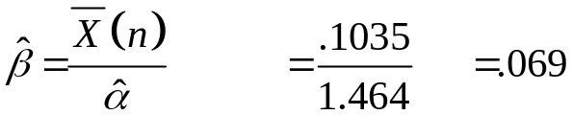
Parameter Estimation
To estimate parameters for our distribution, we use the Maximum Likelihood Estimators (MLE’s) for the selected distribution.
For a gamma we’ll use the following approximation. Calculate T:
Use table 6.20 to obtain α. α = 1.464
Calculate B:
JPC

Slide 26

A Note on MLEs
Maximum likelihood estimator (MLE)
Method for determining parameters of a hypothesized distribution.
We assume that we have collected n IID observations.
We define the likelihood function:
The MLE is simply the value of theta that maximizes L(θ) over all values of θ.
In simple terms, we want to pick an MLE that will give us a good estimate of the underlying parameter of interest.
JPC

Slide 27
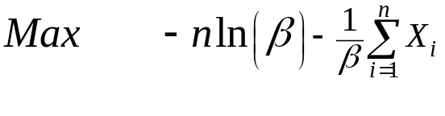
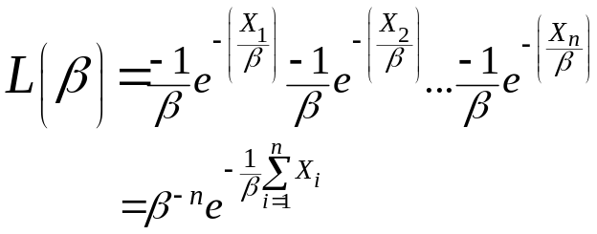
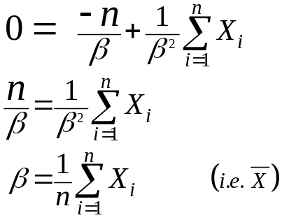
MLE for an Exponential Distribution
We want to estimate ß:
Take the 1st derivative and set = 0. Solve for ß
So, the problem is to maximize the rhs of the above equation. To make things simpler we’ll maximize ln(L(ß))
In general the MLEs are difficult to calculate for most distributions. See Chapter 6 of Law and Kelton.
JPC

Slide 28
Determining the “Goodness” of the Model
As you might imagine, determine whether our hypothesize model is “good” is fraught with difficulties.
Law and Kelton suggest both heuristic and analytical tests to determine “goodness”.
Heuristic tests:
  Density/Histogram over plots.
  Frequency comparisons.
  Distribution function difference plots.
  Probability-Probability Plots (P-P plots).
Analytical tests:
  Chi-Squared tests.
  Kolmogorov-Smirnov tests
JPC

Slide 29
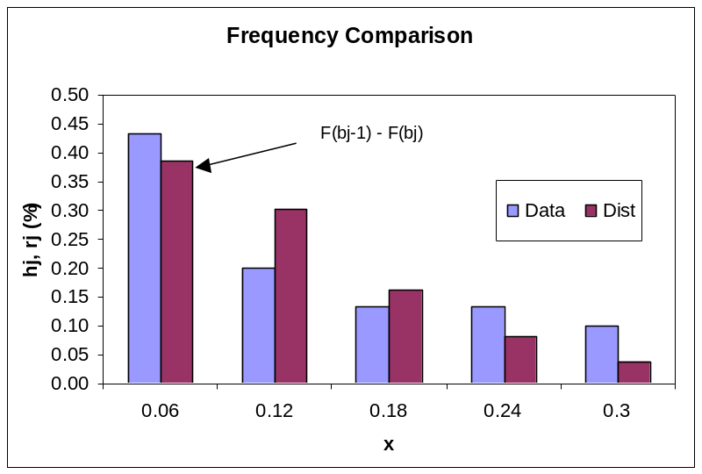
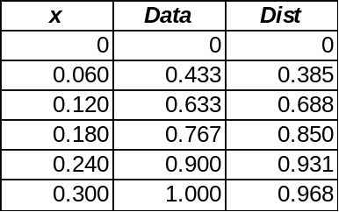
Frequency Comparisons
Cum. Distn Functions
JPC

Slide 30
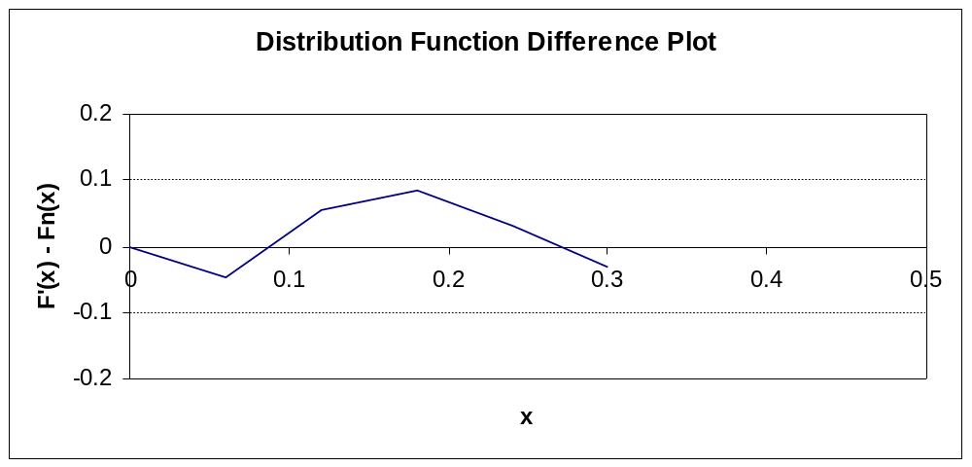
Distribution Function Difference Plot
Plot the CDF of the hypothesized distribution – the CDF as observed in the data.
If the fit is perfect, this plot should be a straight line at 0.
L&K suggest the difference should be less than .10 for all points.
JPC

Slide 31
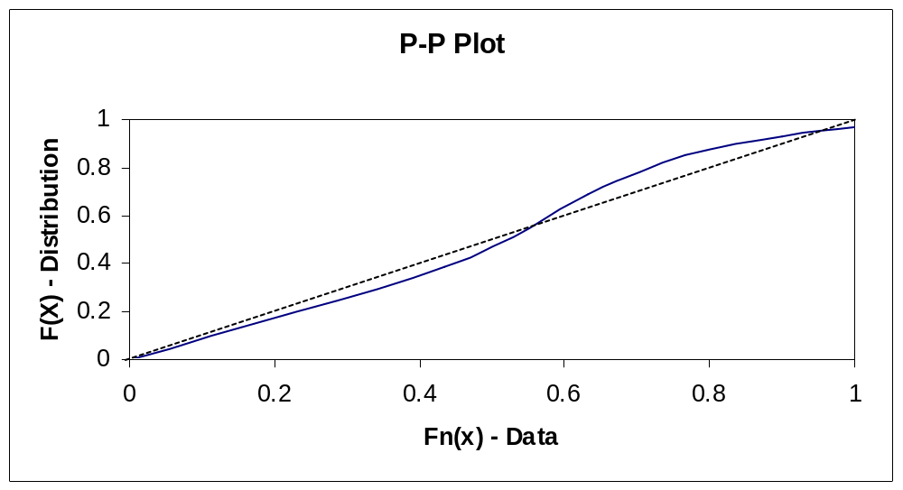
P-P Plot
Note: We are plotting F(x) vs. F
JPC

Slide 32
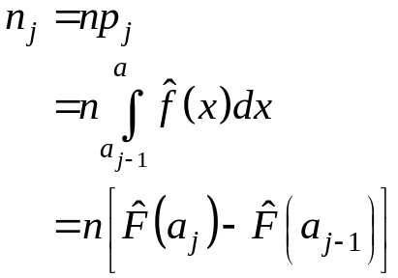
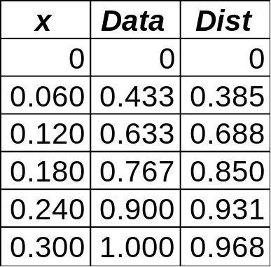
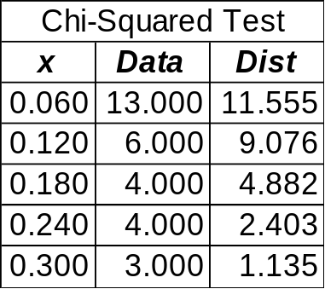
Analytic Test – Chi Squared Test
Divide the range into k adjacent intervals.
N_{j} = # of X_{i}’s in j_{th} interval.
Determine the proportion of X_{i}’s that should fit into the j_{th} interval.
JPC

Slide 33
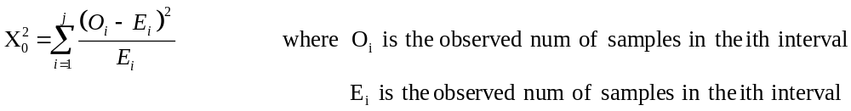
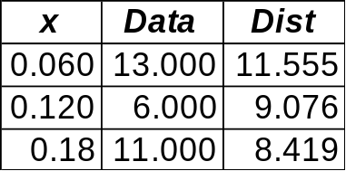
Analytic Test – Chi Squared Test
The critical test statistic is:
A number of authors suggest that the intervals be grouped such that E_{i} is >= 5 or greater than 10 in all cases.
H₀: X conforms to the assumed distribution.
H₁: X does not conform to the assumed distribution.
Reject if X₀² > X²_{α,j-1}
JPC

Slide 34
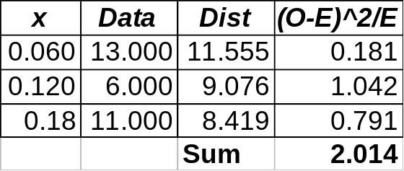
Analytic Test – Chi Squared Test
k is 3, s = 1 (we are estimating two parameters).
If we use α = 0.05, then the critical value of χ²_{2.95,1} is 5.991. Thus, we have no reason to reject the claim that X conforms to the assumed distribution.
Note: The Chi-Squared statistic is notoriously weak. See L&K for a review of more rigorous analytic tests.
JPC

Slide 35
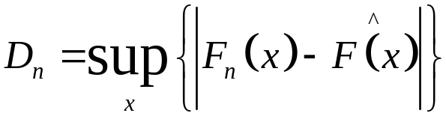
The Kolomogorov-Smirnov (K-S) Test
The K-S test compares an empirical distribution function(F^(x)) with a hypothesized distribution function (F_{n}(x)).
The K-S test is somewhat stronger than the Chi-Square test.
This test doesn’t require that we aggregate any of our samples into a minimum batch size.
We define a test statistic D_{n}:
The largest value over all x
JPC

Slide 36
K-S Example
Let’s say we had collected 10 samples (0.09, 0.23, 0.24, 0.26, 0.36, 0.38, 0.55, 0.62, 0.65, and 0.76) and have developed an emprical cdf.
We want to test the hypothesis that our sample is drawn from a U(0,1) distribution
f(x) = 1 0 <= x <= 1
F(x) = x 0 <= x <= 1
Where
H₀ : F_{n}(x) = F^(x)
H₁ : F_{n}(x) <> F^(x)
JPC

Slide 37
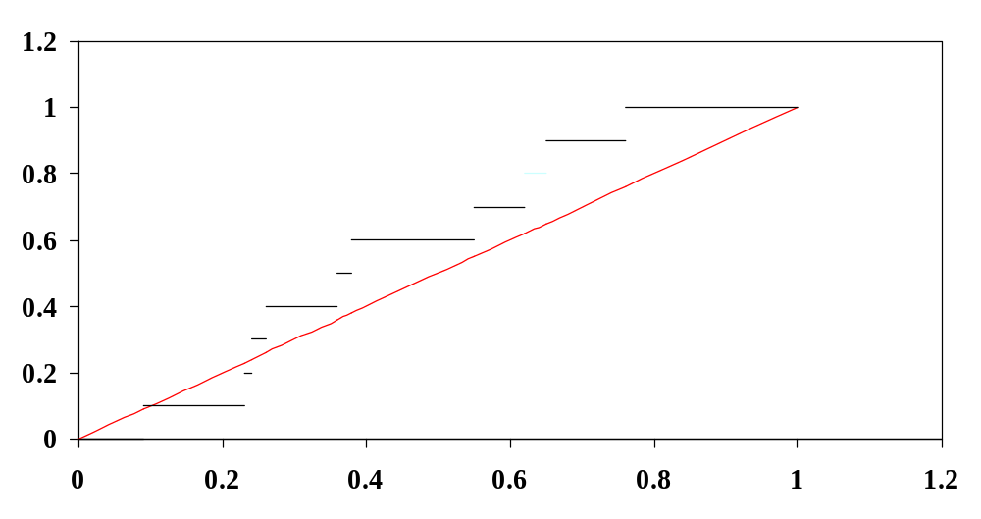
K-S Example
F _{n}(x)
F ^(x)
JPC

Slide 38
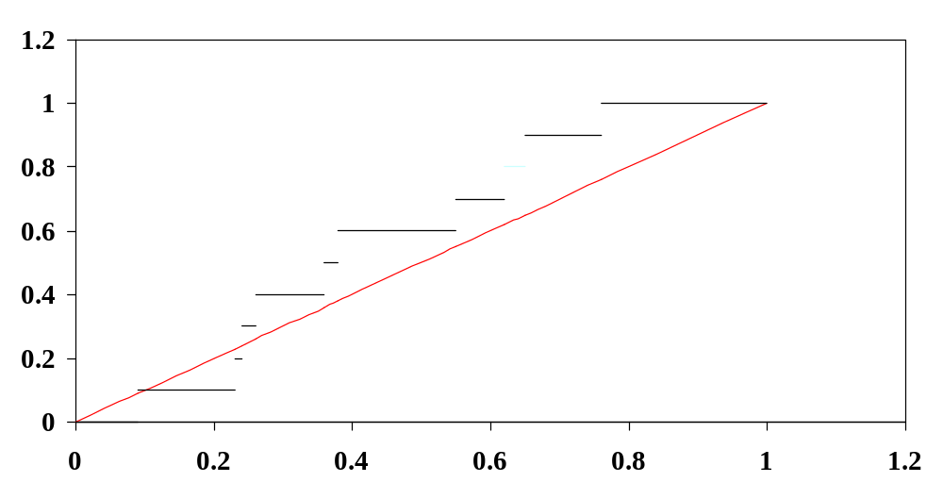
K-S Example
D_{n} is simply the largest of the gaps between F^(x) and F_{n}(x). Remember – we need to find the D_{n}⁻ and D_{n}⁺ at every discontinuity
JPC

Slide 39
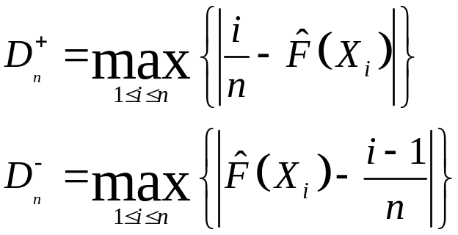
K-S Example
JPC

Slide 40
K-S Example
Sample | x | F^(x) (Fit Distribution) | F_{n}(x) (Empirical) | D_{n}⁻ | D_{n}⁺
0 | 0 | 0 | 0
1 | 0.09 | 0.09 | 0.1 | 0.09 | 0.01
2 | 0.23 | 0.23 | 0.2 | 0.13 | 0.03
3 | 0.24 | 0.24 | 0.3 | 0.04 | 0.06
4 | 0.26 | 0.26 | 0.4 | 0.04 | 0.14
5 | 0.36 | 0.36 | 0.5 | 0.04 | 0.14
6 | 0.38 | 0.38 | 0.6 | 0.12 | 0.22
7 | 0.55 | 0.55 | 0.7 | 0.05 | 0.15
8 | 0.62 | 0.62 | 0.8 | 0.08 | 0.18
9 | 0.65 | 0.65 | 0.9 | 0.15 | 0.25
10 | 0.76 | 0.76 | 1.0 | 0.14 | 0.24
Our D_{n} is the largest of the D_{n}⁻, D_{n}⁺ columns. In this case D_{n} = 0.25.
JPC

Slide 41
K-S Test
The value of D_{n} when appropriately adjusted (see next slide), is found to be < the critical point (1.224) for α = 0.10.
Thus we cannot reject H_{0.}
JPC

Slide 42
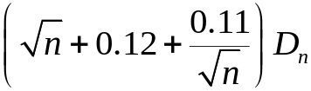
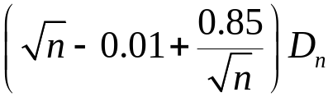


Adjusted Critical Values
Law and Kelton present critical values for the K-S tables that are non-standard.
They use a compressed table based on work from Stevens (1962).
Case | Mulitply D_{n} by
All parameters in F^(x) known
Normal Dist^{n}
Expo Dist_{n}
For tables of critical values see pgs 365-367 of L&K
JPC

